Slide 1
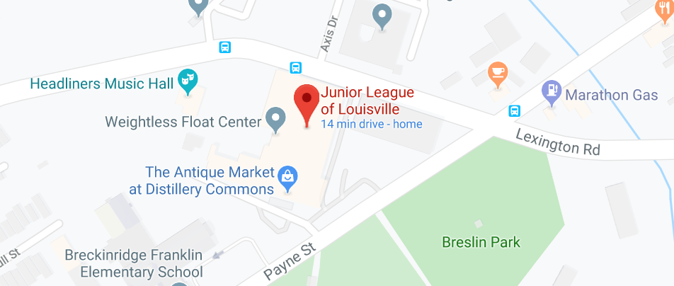
Park Here
Option 2 for parking

